Slide 1
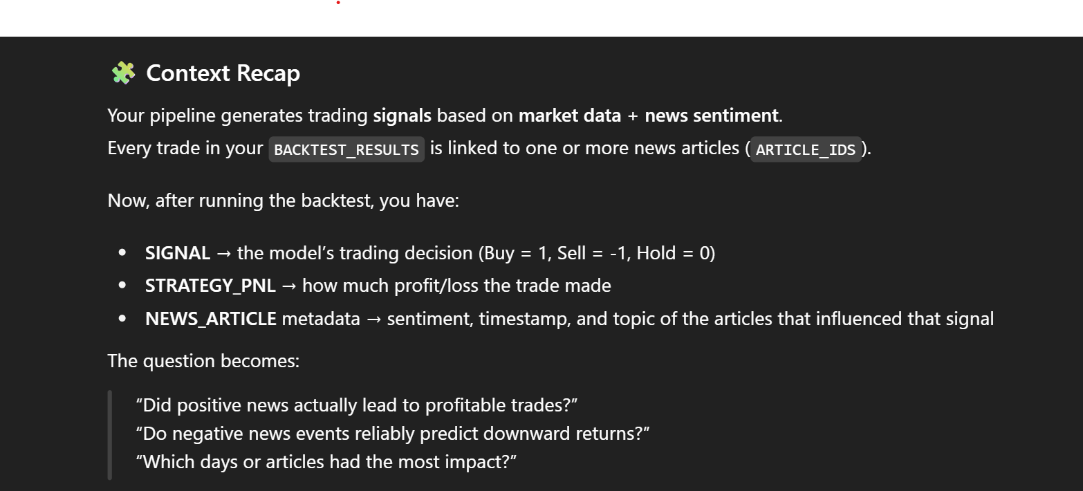
🧩Solution Overview

Slide 2

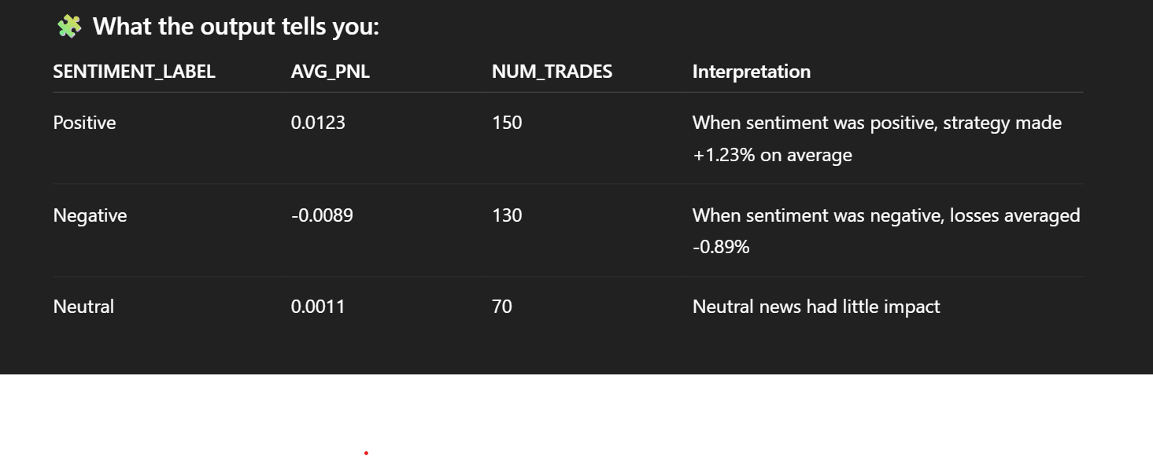
🧩Solution Overview

Slide 3
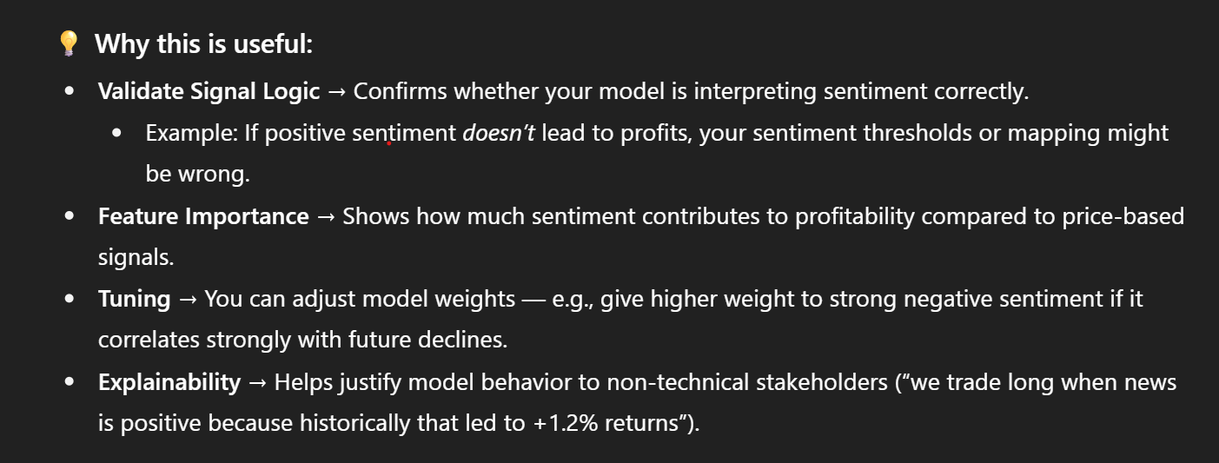

🧩Solution Overview

Slide 4
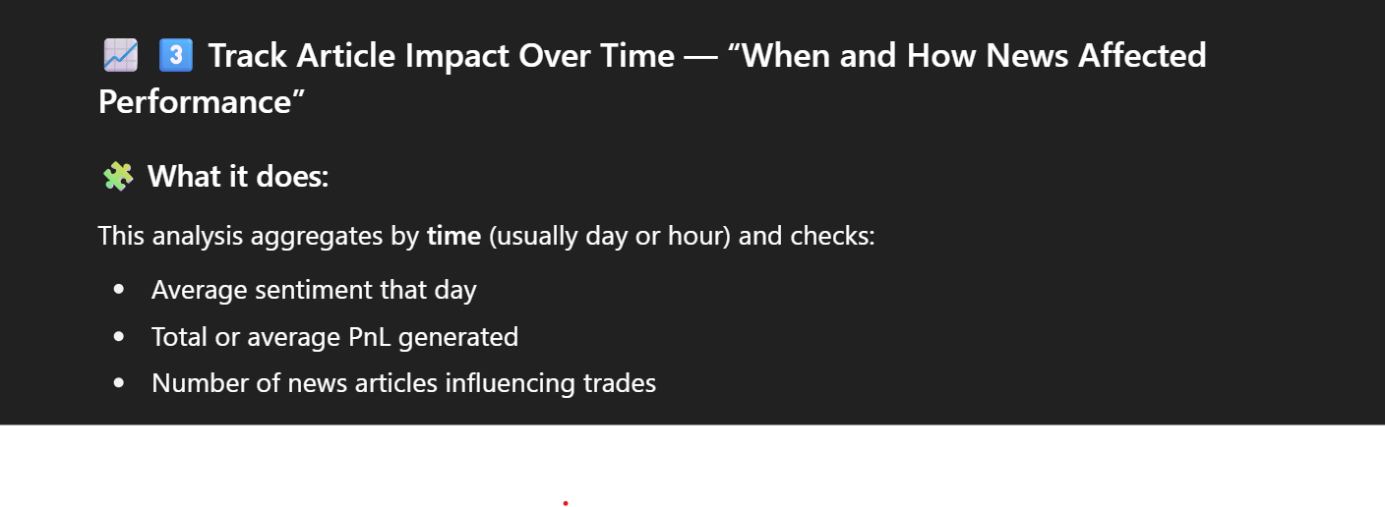
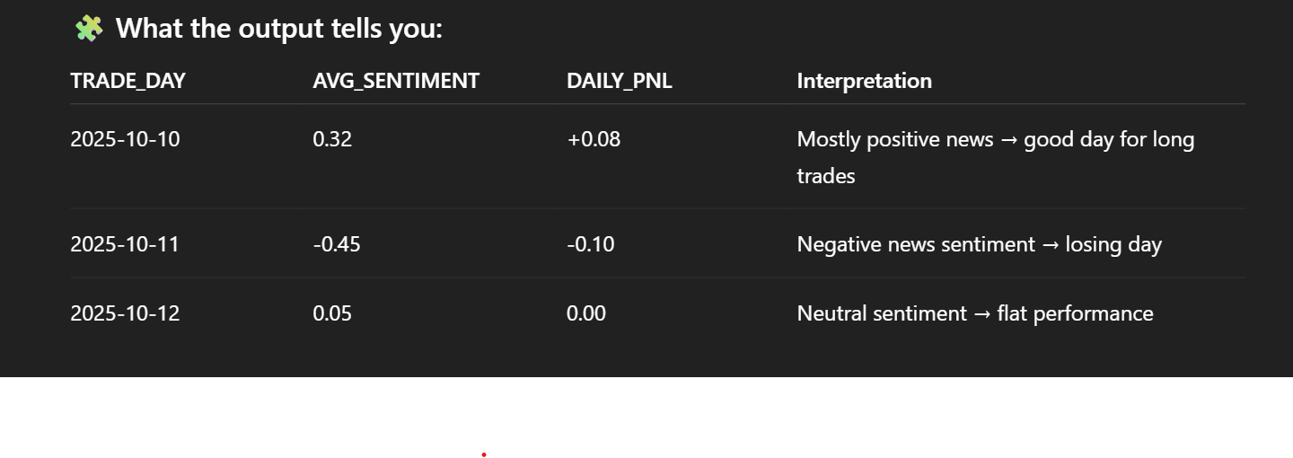
🧩Solution Overview

Slide 5

🧩Solution Overview

